Slide 1
COMP 3064
Game Development
Week 13
Lights

Slide 2
Today
Lights
Ambient
Point
Directional
Spot
Reflections
… and more

Slide 3
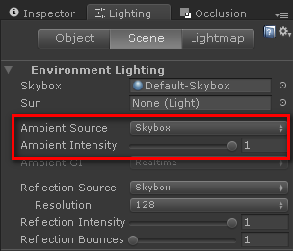
Ambient Light
A light present in the environment
Equally affects all objects

Slide 4
Reflections
Reflected path that changes with the angle of the camera. Applied independently of Ambient.
If Reflection Probes are used they become the Reflection Source and Intensity for the objects under their influence, so the global reflection settings don’t have effect on these objects.
Reflection Bounces define how much times the reflection can bounce among several probes (i.e. a probe capturing the objects under the influence of another probe).

Slide 5
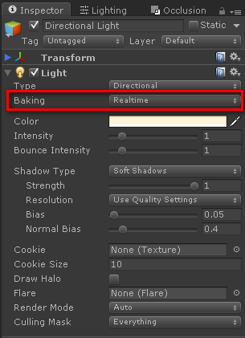
Standard lights
All standard realtime lights in the scene apply direct lighting and shadows on the objects.
The first Directional Light in the scene is considered as Sun by default. The default Skybox gets its intensity and color adjusted depending on the Sun’s horizontal inclination.
Alternatively, a specific directional light can be selected as Sun for affecting the default Skybox

Slide 6
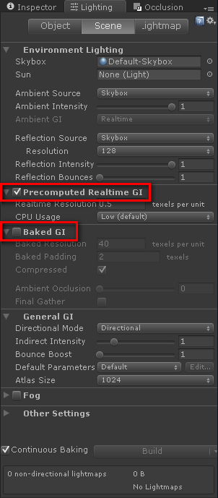
Precomputed realtime lighting
Precomputed realtime lighting throws in light bounces, color bleeding, and emissive materials in real time.
Everything can change dynamically (light color and intensity, material color, material emission, etc) an the lighting gets updated in the scene accordingly in real time.

Slide 7
Emissive materials
Objects flagged as Static containing an emissive material emit light according to their geometry.
Precomputed realtime lighting is calculated on the scene objects flagged as Static. A precompute phase is triggered whenever the Transform of any object marked as Static is modified, or when the Static flag itself changes.

Slide 8
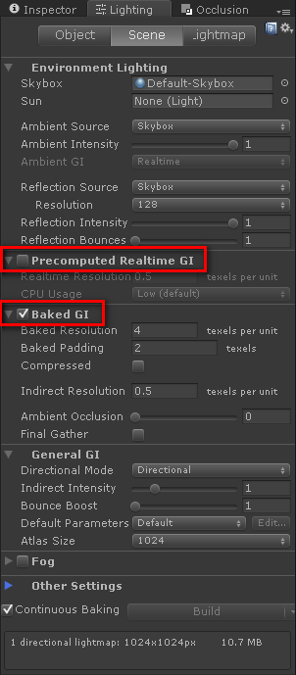
Baked lightmaps
Ambient Light, Standard Lights (baked or mixed), Light Bounces and Emissive Materias are baked into lightmap textures.
Only Environment Reflection can change in runtime.
Lighting > Scene > Baked GI enabled, Precomputed Realtime GI disabled
Standard Lights should be configured as Baked or Mixed for allowing to seamlessly switching among Bake only and Realtime only GI modes.

Slide 9
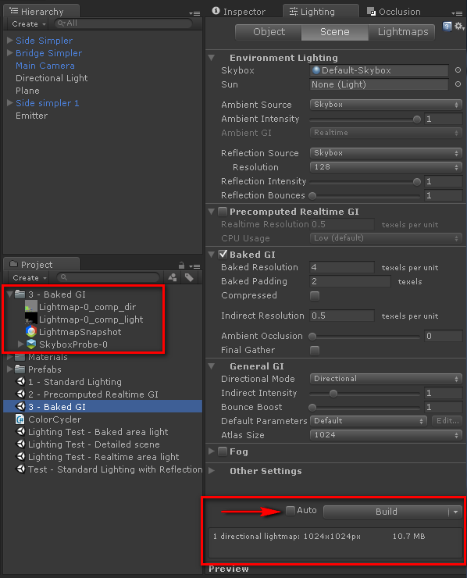
Generating lightmap files
By default lightmap files are generated and stored internally each time a lightmap calculation phase is triggered (i.e. by moving static elements).
Lightmaps can be calculated manually by disabling the Auto checkbox in the Lighting window, then clicking the Build button. The generated files are stored in a folder with the same name as the scene they belong to. Baked data includes lightmaps and reflection probes.
The parameters Directional Mode and Atlas Size at the General GI section affect the type and number of the lightmap files.

Slide 10
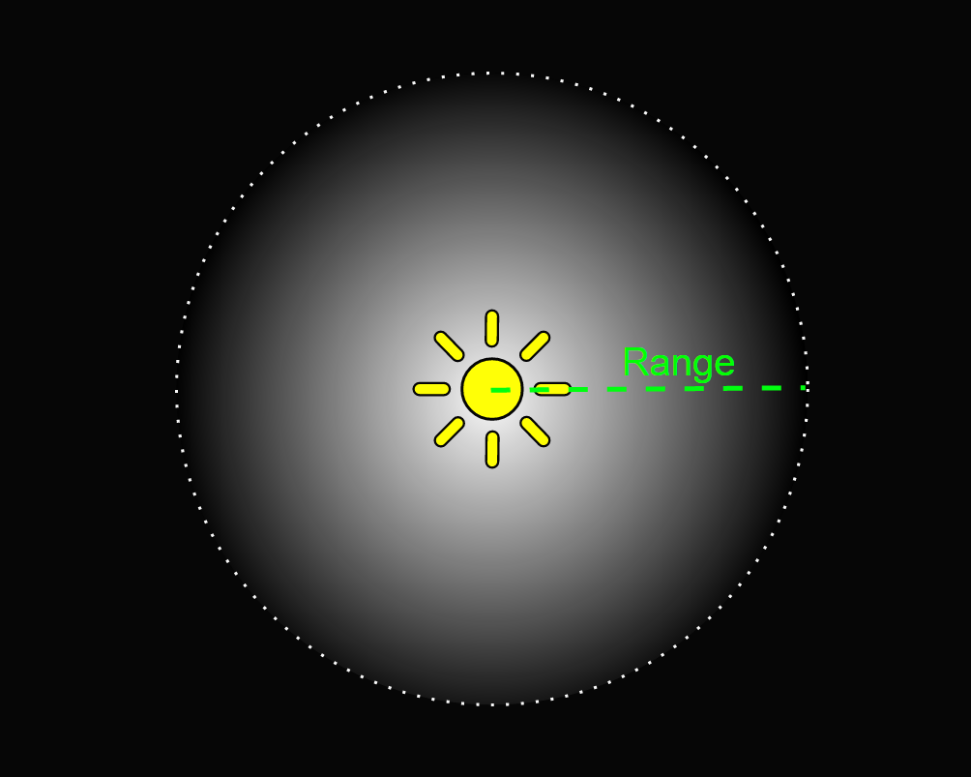
Point lights
A point light is located at a point in space and sends light out in all directions equally.
The direction of light hitting a surface is the line from the point of contact back to the center of the light object.
The intensity diminishes with distance from the light, reaching zero at a specified range. Light intensity is inversely proportional to the square of the distance from the source.
This is known as ‘inverse square law’ and is similar to how light behaves in the real world.

Slide 11
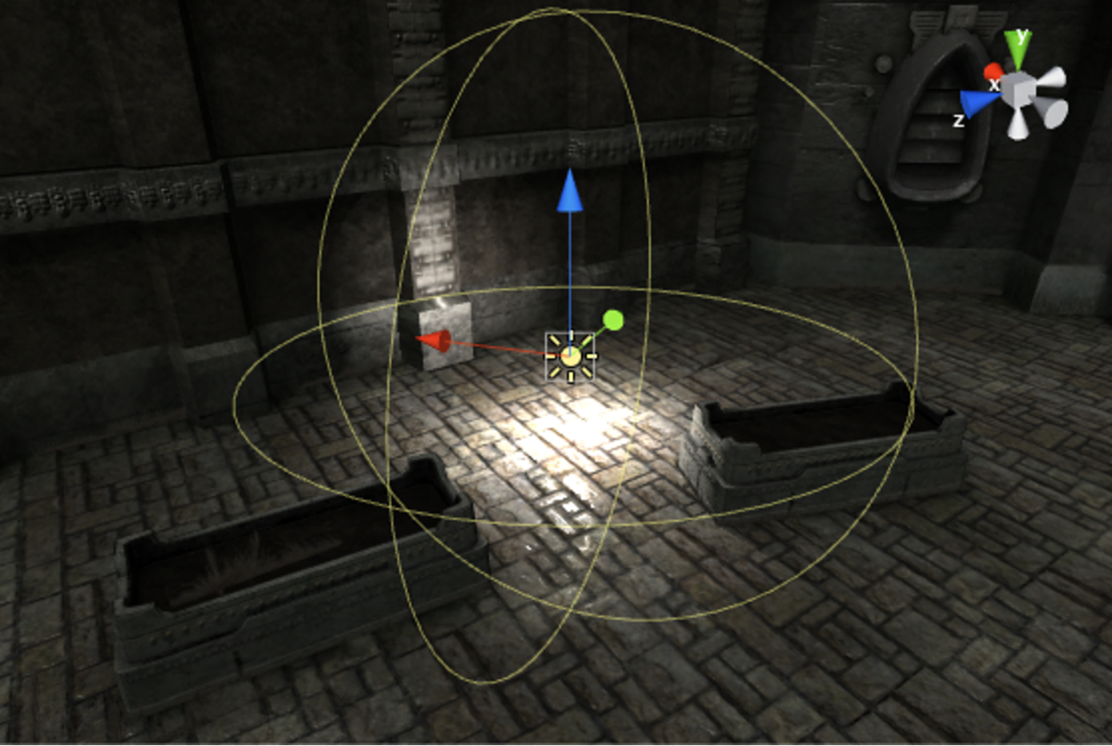

Slide 12
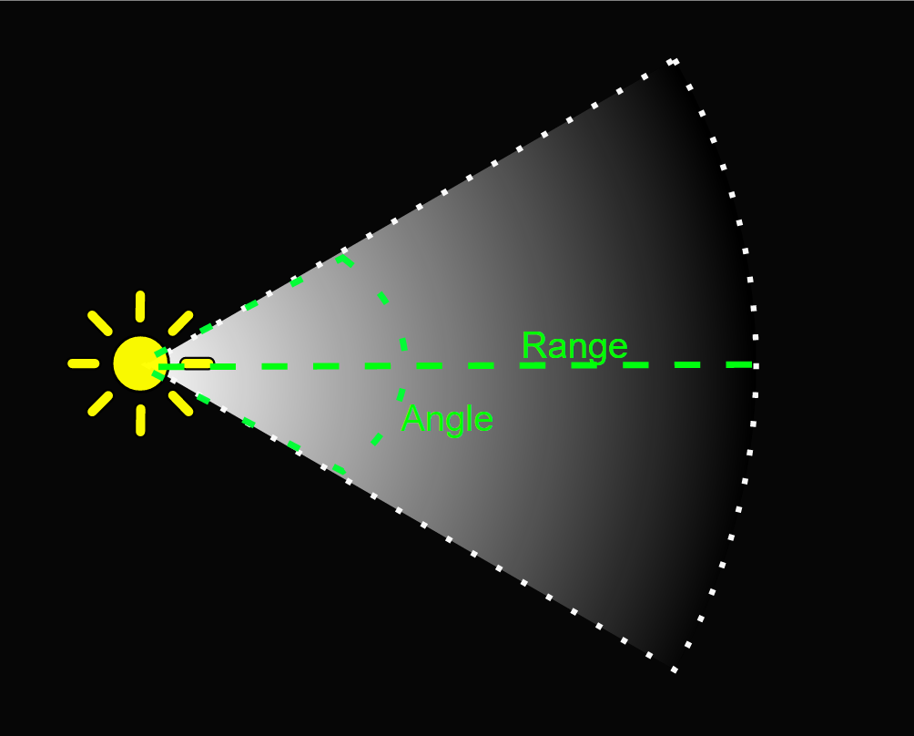
Spot lights
Like a point light, a spot light has a specified location and range over which the light falls off.
However, the spot light is constrained to an angle, resulting in a cone-shaped region of illumination.
The center of the cone points in the forward (Z) direction of the light object.
Light also diminishes at the edges of the spot light’s cone.
Widening the angle increases the width of the cone and with it increases the size of this fade, known as the ‘penumbra’.

Slide 13
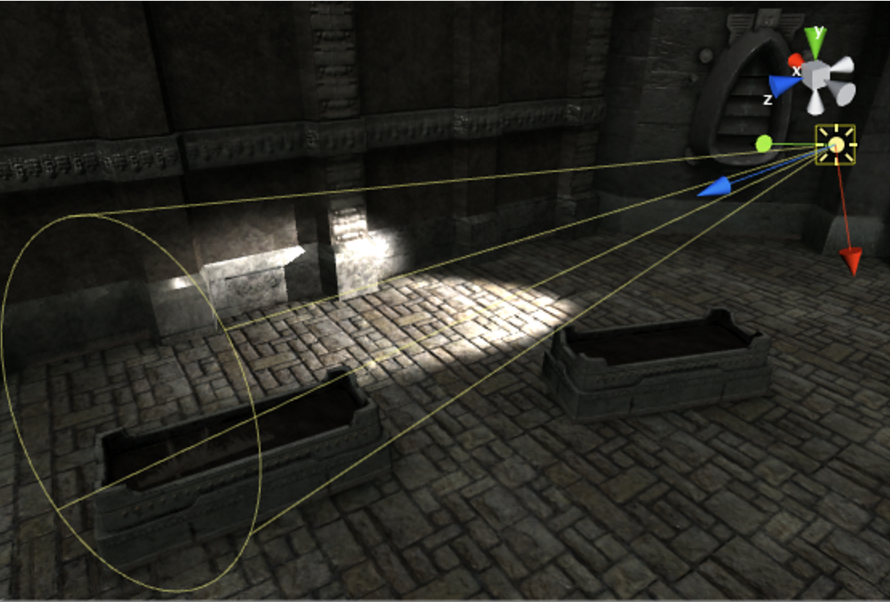

Slide 14
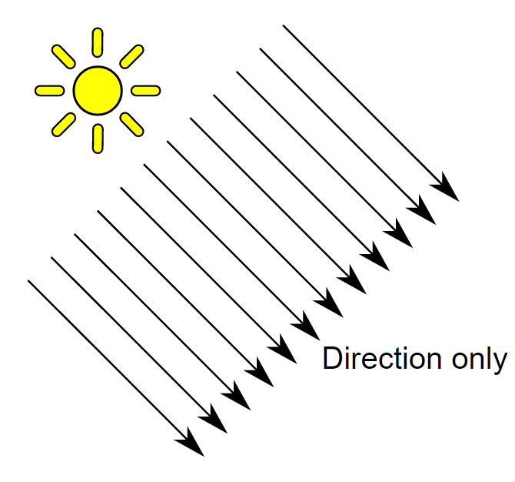
Directional lights
Directional lights are very useful for creating effects such as sunlight in your scenes.
Behaving in many ways like the sun, directional lights can be thought of as distant light sources which exist infinitely far away.
A directional light does not have any identifiable source position and so the light object can be placed anywhere in the scene.
All objects in the scene are illuminated as if the light is always from the same direction.
The distance of the light from the target object is not defined and so the light does not diminish.

Slide 15
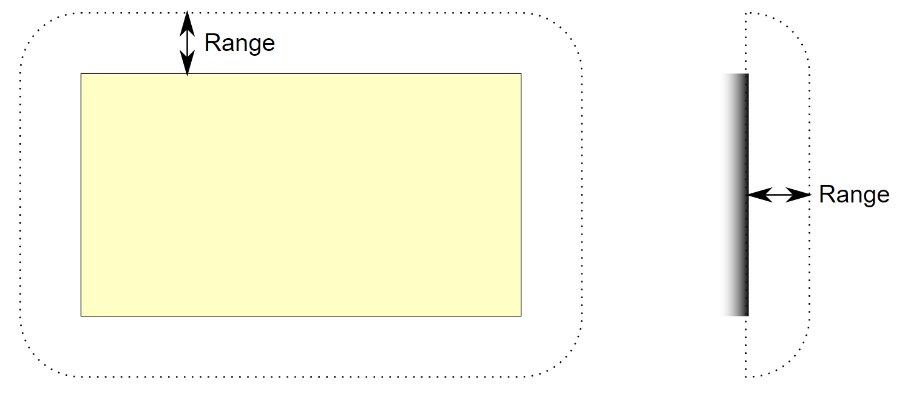
Area lights
An Area Light is defined by a rectangle in space.
Light is emitted in all directions uniformly across their surface area, but only from one side of the rectangle.
There is no manual control for the range of an Area Light, however intensity will diminish at inverse square of the distance as it travels away from the source.
Since the lighting calculation is quite processor-intensive, area lights are not available at runtime and can only be baked into lightmaps.

Slide 16

Demo

Slide 17
Questions?

